Slide 1
Azure Stack
Notes:
Information in this document, including URL and other Internet Web site references, is subject to change without notice. Unless otherwise noted, the example companies, organizations, products, domain names, e-mail addresses, logos, people, places, and events depicted herein are fictitious, and no association with any real company, organization, product, domain name, e-mail address, logo, person, place or event is intended or should be inferred. Complying with all applicable copyright laws is the responsibility of the user. Without limiting the rights under copyright, no part of this document may be reproduced, stored in or introduced into a retrieval system, or transmitted in any form or by any means (electronic, mechanical, photocopying, recording, or otherwise), or for any purpose, without the express written permission of Microsoft Corporation.
Microsoft may have patents, patent applications, trademarks, copyrights, or other intellectual property rights covering subject matter in this document. Except as expressly provided in any written license agreement from Microsoft, the furnishing of this document does not give you any license to these patents, trademarks, copyrights, or other intellectual property.
The names of manufacturers, products, or URLs are provided for informational purposes only and Microsoft makes no representations and warranties, either expressed, implied, or statutory, regarding these manufacturers or the use of the products with any Microsoft technologies. The inclusion of a manufacturer or product does not imply endorsement of Microsoft of the manufacturer or product. Links may be provided to third party sites. Such sites are not under the control of Microsoft and Microsoft is not responsible for the contents of any linked site or any link contained in a linked site, or any changes or updates to such sites. Microsoft is not responsible for webcasting or any other form of transmission received from any linked site. Microsoft is providing these links to you only as a convenience, and the inclusion of any link does not imply endorsement of Microsoft of the site or the products contained therein.
© 2018 Microsoft Corporation. All rights reserved.
Microsoft and the trademarks listed at https://www.microsoft.com/en-us/legal/intellectualproperty/Trademarks/Usage/General.aspx are trademarks of the Microsoft group of companies. All other trademarks are property of their respective owners.

Slide 2
Abstract and learning objectives
In this whiteboard design session, you will work with a group to design a hybrid cloud architecture using a combination of the Azure public cloud and Azure Stack. This functional architecture will enable customers to leverage their investments in Azure as a "cloud platform," rather than Azure as a "place.“
At the end of the session, you will be able to determine which systems are good candidates for the Azure public cloud, and which are better suited on Azure Stack.

Slide 3
Step 1: Review the customer case study
Outcome
Analyze your customer needs.
Timeframe
15 minutes

Slide 4
Customer situation - Contoso Financial
Headquartered in Dallas, TX with a substantial residential mortgage business.
Moving to a cloud first model as part of a larger digital transformation.
Strong interest in PaaS and consistent operational model to increase agility and lower management overhead.

Slide 5
Customer situation - Contoso Financial
Contoso recently acquired Fabrikam, a financial analytics company based in Houston, TX.
Fabrikam has already its Azure AD tenant and significant experience in working with Azure
Contoso wants to leverage Fabrikam’s experience and provide its IT staff a sufficient level of autonomy in managing computing resources.

Slide 6
Customer situation - Contoso Financial
“I have seen how applications and infrastructures are deployed and run using Microsoft Azure with both PaaS and IaaS services. These capabilities can transform Contoso with more agility and long-term cost effectiveness”
– Doreen Newton, CTO

Slide 7
Customer situation - Contoso Financial
One of the primary applications Contoso is interested in modernizing to take advantage of the cloud is their consumer facing mortgage application.
This application is responsible for new applications and consumer access to their current mortgage information.
Contoso wants to integrate Fabrikam’s internal apps to process and analyze data used by its mortgage application.

Slide 8
Customer situation - Contoso Financial
Current system is hosted in Contoso’s Dallas datacenter (production) and Contoso's Tulsa datacenter (DR)
Virtual Machines hosted in VMWare
Technology stack:
Internet Information Server (IIS) for the web tier.
Application tiers consist of several custom Windows Services.
Microsoft Message Queue (MSMQ) for messaging between tiers.
SQL Server 2012 database.

Slide 9
Customer situation - Contoso Financial
Consumer facing mortgage application high-availability:
Load balanced web tier with two VMs
Multiple application server VMs
Three VMs in a SQL Server Always On Availability Group cluster with the synchronous commit mode.
Consumer facing mortgage application disaster recovery:
Application and web tier matching production
SQL Server hosting the replicas of production databases using transactional replication with Always On-based publisher

Slide 10








Customer situation
Application servers
Queue
Public facing Web servers
SQL servers
Contoso customers
Contoso data center, (Dallas, TX)
DR site (Tulsa, OK)

Slide 11
Customer situation - Contoso Financial
During the planning stages, the corporate compliance team determined that US-based customer data cannot reside in the Azure public cloud.
“This was a cause for great concern, as this means Contoso may not be able to move to cloud-based services as initially envisioned” says Max Rubin VP of Network engineering.
Doreen Newton took on the challenge to investigate alternatives by turning to FusionTumo.

Slide 12
Customer situation - Contoso Financial
Contoso wants to expand its mortgage business to Canada
Some types of Canada-based customer data cannot be:
transferred to the US
stored in Azure
Mortgage data is needed by custom ERP/CRM apps in the US
Custom ERP/CRM data feeds do not work reliably over WAN

Slide 13
Customer needs
Design a hybrid-cloud architecture that is native Azure end-to-end without the need for hosting the application in a Contoso owned, US-based datacenter.
Incorporate into the design high availability and disaster recovery provisions for the customer-facing Mortgage Application.
Ensure that customer data is not stored in the Azure Cloud while also allowing future applications to be easily deployed in Azure with access to custom data regardless of where they are deployed.

Slide 14
Customer needs
Account for the Contoso's intention to expand its business to Canada, including provisions regarding protecting sensitive customer data while also making it available for processing by internal ERP and CRM systems.
Propose management and monitoring approach that would provide consistency in a hybrid environment.
Deploy the application in a secure manner as to allow for the frontend applications to access the backend customer data.

Slide 15
Customer needs
Establish direct connectivity from the new regional headquarters in Dallas to the deployments. This will allow communication with existing systems and reporting until the rest of Contoso's services are moved to Azure in the future.
Allow for a consistent application deployment model using Azure ARM templates and CI/CD.
Detail the taxonomy that will be leveraged for the hybrid-cloud including the Resource Providers (RP) This includes tenants, regions, subscriptions, offers, plans, services and quotas.

Slide 16
Customer needs
Design an integration model that would allow resource access for both Contoso and Fabrikam users.
Propose a self-service approach that will allow Contoso and Fabrikam developers provision their own resources from the service catalog offered by infrastructure teams. The scope of resources available in service catalog must be controlled centrally, with an oversight by designated Contoso and Fabrikam administrators.

Slide 17
Customer needs
Recommend a procedure for delegation of permissions that would not only allow designated Fabrikam IT admins to manage Contoso infrastructure but also account for the need to provide limited access to the Contoso internal audit team.
Suggest a methodology that would facilitate implementing corporate standards by automating the process of resource provisioning and configuration.
Document standard operational tasks such as infrastructure backup and log collection.

Slide 18
Customer objections
The Customer Data SQL Server database cannot be hosted in the public cloud.
Contoso will have a very limited staff to manage the US based operations, so minimizing patching of systems and day-to-day management is very important.
Having to manage multiple environments is bound to increase administrative overhead. Is there really a consistent approach we can use in hybrid scenarios?
I'm confused about the differences between different Azure Stack portfolio offerings. Would Azure Stack HCI, Azure Stack Hub, or Azure Stack Edge help us accomplish our objectives with the least amount of administrative overhead and minimized cost?

Slide 19
Customer objections
The developer team acknowledges that the existing application architecture is designed for running on Windows Virtual Machines, but PaaS is the future they envision. How can they move this application forward?
The developer team acknowledged that the existing application architecture is designed for running on Windows virtual machines, but PaaS is the future they envision. How should they transition to this model?
One of the key reasons Contoso wants to go to the cloud is to take advantage of tools and services for automated deployments and application development. Do any of Azure Stack portfolio offerings accommodate this approach or do we have to develop and support two distinct operational models?
Fabrikam already has its own Azure Active Directory tenant. Will it be necessary to create duplicate accounts for Fabrikam users?

Slide 20
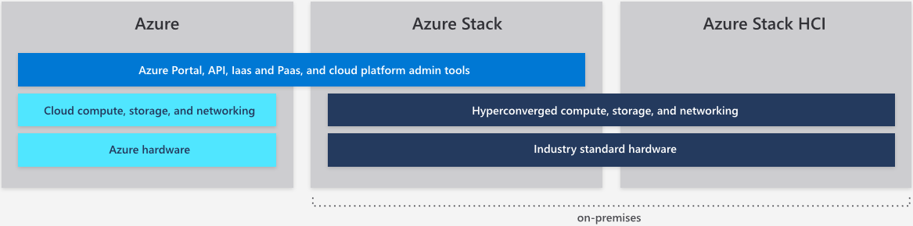
Common scenarios

Slide 21
Step 2: Design the solution
Outcome
Design a solution and prepare to present the solution to the target customer audience in a 15-minute chalk-talk format.
Timeframe
60 minutes
Business needs (10 minutes) | Respond to questions outlined in your guide and list the answers on a flipchart.
Design (35 minutes) | Design a solution for as many of the stated requirements as time allows. Show the solution on a flipchart.
Prepare (15 minutes) | Identify any customer needs that are not addressed with the proposed solution. Identify the benefits of your solution. Determine how you will respond to the customer’s objections. Prepare for a 10-minute presentation to the customer.

Slide 22
Step 3: Present the solution
Outcome
Present a solution to the target customer in a 15-minute chalk-talk format .
Timeframe
30 minutes (15 minutes for each team to present and receive feedback)
Directions
Pair with another table.
One table is the Microsoft team and the other table is the customer.
The Microsoft team presents their proposed solution to the customer.
The customer asks one of the objections from the list of objections in the case study.
The Microsoft team responds to the objection.
The customer team gives feedback to the Microsoft team.

Slide 23
Wrap-up
Outcome
Identify the preferred solution for the case study.
Identify solutions designed by other teams.
Timeframe
15 minutes

Slide 24
Preferred target audience
Doreen Newton, CTO
Max Rubin, VP of Networks
Contoso Teams:
Networking, Security, DevOps and Application Owners
Fabrikam Teams:
Networking, Security, DevOps and Application Owners
FT Teams
Azure Stack, Networking

Slide 25
Preferred solution: hybrid cloud architecture
Solution overview
Hybrid deployment of Azure Public and Azure Stack Hub.
Application components will run in Azure and Azure Stack Hub.
Traffic Manager to automatically direct traffic to Azure and Azure Stack Hub.
Customer data will reside in Azure Stack Hub.

Slide 26
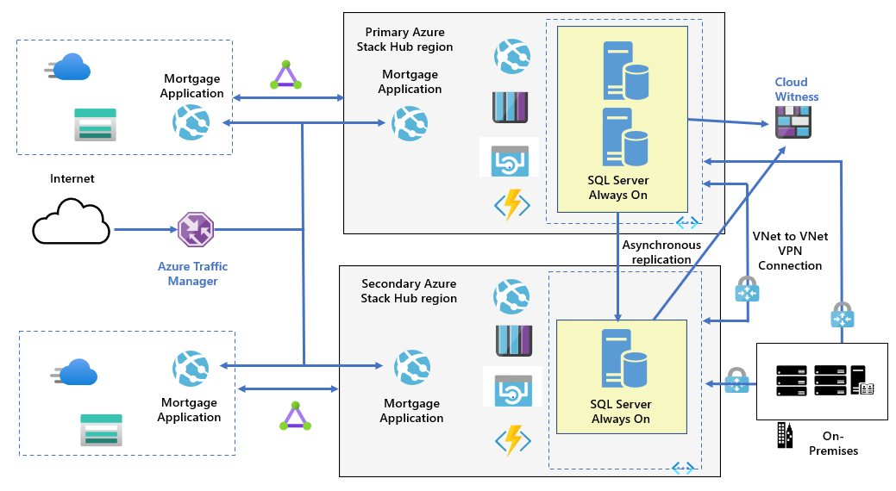
Preferred solution: hybrid cloud architecture

Slide 27
Preferred solution: hybrid cloud architecture
Locations
production environment for US-based customers
Global Azure cloud in the South Central US region and an Azure Stack Hub integrated system running in the FT Dallas datacenter
disaster recovery environment for US-based customers
Global Azure cloud in the North Central US region and an Azure Stack Hub integrated system running in the FT Chicago datacenter
production environment for Canada customers
Global Azure cloud in the Canada Central region and an Azure Stack Hub integrated system running in the FT Toronto datacenter

Slide 28
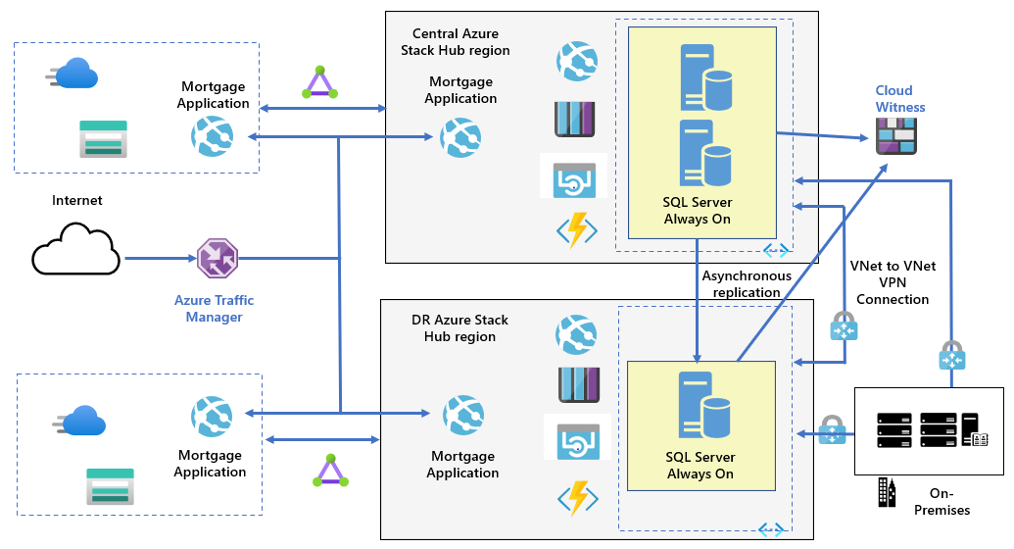
Preferred solution: hybrid cloud architecture

Slide 29
Preferred solution: hybrid cloud architecture
Components
Azure Web Apps and API Apps
Azure Storage blobs
Azure Storage queues
Azure Functions
Virtual machines
Azure Traffic Manager
Azure Content Delivery Network (CDN)

Slide 30
Preferred solution: hybrid cloud architecture
Components (Global Azure cloud)
Azure Web App for the Mortgage Application code
Azure Storage blobs for PDF files and Cloud Witness blob
Azure Traffic Manager for routing web traffic to either the Azure public web apps or the web apps on Azure Stack Hub.
Azure Content Delivery Network (CDN) or caching publicly accessible PDF files.

Slide 31
Preferred solution: hybrid cloud architecture
Components (Azure Stack Hub) FT Dallas, TX
2 web apps (Mortgage Applications and Mortgage Admin), API apps, a function app
Azure Storage blobs for PDFs
Azure Storage queues for the Mortgage Application messaging.
2 VMs (Windows Server 2019 VMs/SQL Server 2019) with the Web App DB and Customer Data databases in an Always On Availability Group (the synchronous-commit mode) and a subscriber database for the Customer Data database in the FT datacenter in Toronto, ON)
2 VNet-to-VNet VPN connections (to the Azure Stack Hub in the FT datacenter in Chicago, IL and in Toronto, ON)

Slide 32
Preferred solution: hybrid cloud architecture
Components (Azure Stack Hub) FT Chicago, IL (DR site)
2 web apps (Mortgage Applications and Mortgage Admin), API apps, a function app
Azure Storage blobs for PDFs
Azure Storage queues for the Mortgage Application messaging.
1 VM (Windows Server 2019 VMs/SQL Server 2019) with the Web App DB and Customer Data databases in the Always On Availability Group (the asynchronous-commit mode).
1 VNet-to-VNet VPN connection (to the Azure Stack Hub in the FT datacenter in Dallas, TX)

Slide 33
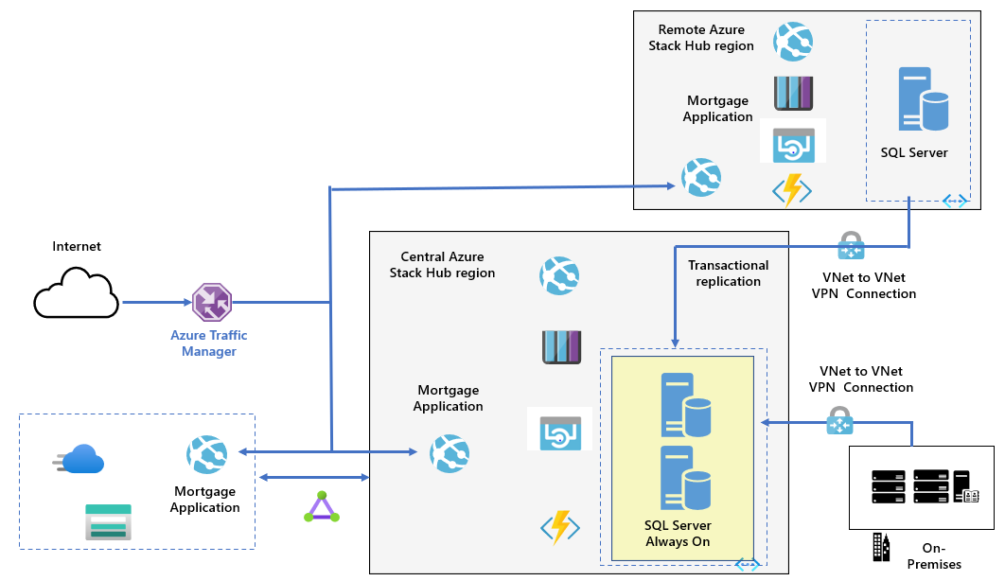
Preferred solution: hybrid cloud architecture

Slide 34
Preferred solution: hybrid cloud architecture
Components (Azure Stack Hub) FT Toronto, ON
2 web apps (Mortgage Applications and Mortgage Admin), API apps, a function app
Azure Storage blobs for PDFs
Azure Storage queues for the Mortgage Application messaging.
2 VMs (Windows Server 2019 VMs/SQL Server 2019) with the Web App DB and Customer Data databases in an Always On Availability Group (the synchronous-commit mode). Customer Data uses transactional replication (filtered) to replicate a database in FT datacenter Dallas, TX
1 VNet-to-VNet VPN connection (to the Azure Stack Hub in the FT datacenter in Dallas, TX)

Slide 35
Preferred solution: hybrid cloud architecture
High availability
Inherent to Azure Stack Hub design
Backed by Azure availability SLAs
Enhanced by using Always On Availability Group (synchronous mode)
Disaster recovery
Web and application tiers: deployed to both regions
Database tier: implemented by using Always On Availability Group (asynchronous mode)
Global load balancing: Traffic Manager

Slide 36
Preferred solution: hybrid cloud architecture
High availability
Inherent to Azure Stack Hub design
Backed by Azure availability SLAs
Enhanced by using Always On Availability Group (synchronous mode)
Disaster recovery
Web and application tiers: deployed to both regions
Database tier: implemented by using Always On Availability Group (asynchronous mode)
Global load balancing: Traffic Manager

Slide 37
Preferred solution: hybrid management
Azure Arc for Servers (once it reaches GA)
Azure Policy guest configuration
Tags
Resource-context access to Log Analytics logs
Azure VM extensions (DSC, Log Analytics, Dependency agent, Custom Script)
Azure Automation
Update Management
State Configuration (DSC)

Slide 38
Preferred solution: Azure Stack Hub taxonomy
Cloud operators
FT will act in this role as the Service Provider.
Through the delegated providers model, Contoso and Fabrikam IT staff will be able to create delegated offers and plans
FT will be able to leverage built-in and custom Role Based Access Control roles to provide restricted access to the Azure Stack Hub Admin portal to Contoso and Fabrikam staff
Regions
One Azure Stack Hub region will be created in the FT Dallas datacenter.

Slide 39
Preferred solution: Azure Stack Hub taxonomy
Tenants
Contoso will be setup as the primary tenant
To accommodate requirements for integration with Fabrikam Azure Active Directory, FT will implement multi-tenant Azure Stack Hub topology.
The same topology can be further extended to include other tenants as Contoso grows its business

Slide 40
Preferred solution: Azure Stack Hub taxonomy
Subscriptions
The Azure Stack Hub environment will contain multiple subscriptions.
Distinct subscriptions will facilitate cost allocation and chargeback processes.
Plans and quotas
FT will create plans to offer the Contoso tenant.
Two plans will initially be created: development and production.
All services will be allowed for these subscriptions with quotas set lower for development.
Offers
Two offers will initially be created: development and production.

Slide 41
Preferred solution: Azure Stack Hub taxonomy
Services / resource providers
The base resource providers will be enabled: compute RP, network RP, storage RP and KeyVault RP.
The Azure App Service RP will be installed and made available.
The Windows Server 2019 and SQL IaaS Extension for Azure Stack Hub will all be enabled through the Azure Stack Hub Marketplace.

Slide 42
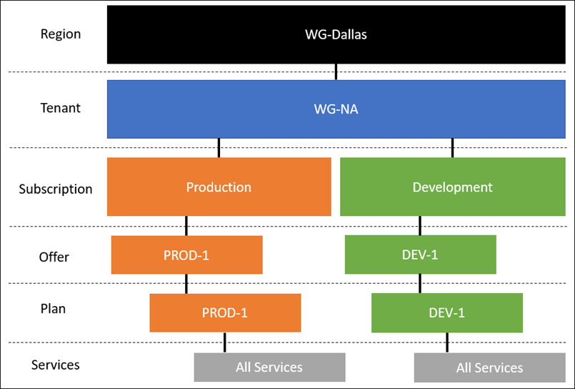
Preferred solution: Azure Stack Hub taxonomy

Slide 43
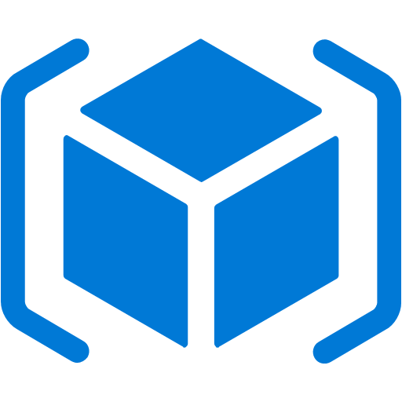
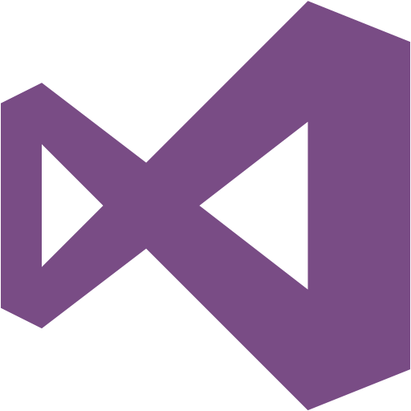
Preferred solution for application deployment
ARM templates
Consistent deployment experience with Azure public cloud and Azure Stack Hub.
Hybrid CI/CD pipeline with VSTS
A hybrid continuous integration/continuous delivery (CI/CD) pipeline enables you to build, test, and deploy your app to multiple clouds.
Notes:
Azure Resource Manager templates can be used to deploy supported services to both Azure Public and Azure Stack Hub.
A hybrid continuous integration/continuous delivery(CI/CD) pipeline enables you to build, test, and deploy your app to multiple clouds. A hybrid CI/CD pipeline can help you:
Initiate a new build based on code commits to your Visual Studio Team Services (VSTS) repository.
Automatically deploy your newly built code to Azure for user acceptance testing.
Once your code has passed testing, automatically deploy to Azure Stack Hub.

Slide 44
Preferred solution: networking
The initial proof of concept will start with providing a S2S VPN between the virtual network the Azure Web App is connected to and Azure Stack Hub and another S2S Gateway between the Azure Stack Hub Datacenter in FT and the Contoso Regional HQ.
Notes:
The initial proof of concept will start with providing a S2S VPN between the virtual network the Azure Web App is connected to and Azure Stack Hub and another S2S Gateway between the Azure Stack Hub Datacenter in FT and the Contoso Regional HQ.
For the future, both S2S and ExpressRoute will be configured for routing using BGP ensuring the best connections possible and one set of configurations for routing. FT will provide the Public ASN number for the routes from their datacenter network in Dallas. FT will also configure the BGP connections between their datacenter and the new routers on-premises at the Contoso Dallas office. Contoso’s Public IP Space will be leveraged along with the addition of public IP Space from FT.

Slide 45
Preferred solution: networking
For the future, both S2S and ExpressRoute will be configured for routing using BGP ensuring the best connections possible and one set of configurations for routing. FT will provide the Public ASN number for the routes from their datacenter network in Dallas. FT will also configure the BGP connections between their datacenter and the new routers on-premises at the Contoso Dallas office. Contoso’s public IP space will be leveraged along with the addition of public IP space from FT.

Slide 46
Customer objections handling
The Customer Data SQL Server database cannot be hosted in the public cloud.
Potential Answer
The SQL Server database containing the customer information will be hosted in each of the Azure Stack Hub regions in the FT datacenters. The data will not traverse or be stored in the Global Azure cloud.

Slide 47
Customer objections
Contoso will have a very limited staff to manage the US based operations, so minimizing patching of systems and day-to-day management is very important.
Potential Answer:
Majority of the services that form the proposed solution in both Global Azure cloud and Azure Stack Hub are implemented as PaaS services. To manage operating system updates on virtual machines hosting SQL Server instances, Contoso can leverage Azure Automation Update Management. Automated installation of SQL Server specific patches can be implemented by using SQL IaaS Extensions for Azure Stack Hub, available from Azure Stack Hub Marketplace.

Slide 48
Customer objections
Having to manage multiple environments is bound to increase administrative overhead. Is there really a consistent approach we can use in hybrid scenarios?
Potential Answer:
Contoso will consider implementing Azure Arc for Servers (once it reaches General Availability). This will allow management of Windows and Linux servers residing in on-premises environments and hosted by 3rd party service providers in the manner similar to that applicable to Azure VMs. These features include Azure Policy-based guest configuration, tags, support for resource-context access to Log Analytics logs, as well as deployment of and management via Azure VM extensions.

Slide 49
Customer objections
I'm confused about the differences between different Azure Stack portfolio offerings. Would Azure Stack HCI, Azure Stack Hub, or Azure Stack Edge help us accomplish our objectives with the least amount of administrative overhead?
Potential Answer:
Azure Stack Hub uses the same underlying technologies as Azure Global cloud, which includes the core IaaS, SaaS, and PaaS capabilities.
Azure Stack HCI solutions facilitates implementing and management of virtual machines in a Microsoft-validated, on-premises HCI deployments.
Azure Stack Edge is an AI-enabled, Microsoft-provided edge computing device with network data transfer capabilities, which primary use cases involve ML inferencing preprocessing of data before sending it to Azure.

Slide 50
Customer objections
The developer team acknowledged that the existing application architecture is designed for running on Windows virtual machines, but PaaS is the future they envision. How should they transition to this model?
Potential Answer
The application code base can be modernized by converting the Windows Services to Azure Functions, messaging based code could use Azure Storage Queues or Service Bus, and code that reads and writes from the file system could be updated to use Azure Storage. Finally, application code that writes to SQL Server could be updated to use SQL Database for data that can be transferred to Azure Global or to SQL database service in Azure Stack Hub.

Slide 51
Customer objections
One of the key reasons Contoso wants to go to the cloud is to take advantage of tools and services for automated deployments and application development. Do any of Azure Stack portfolio offerings accommodate this approach or do we have to develop and support two distinct operational models?
Potential Answer
While there will be minor differences with connectivity/environment information, if the resources are supported in both clouds, the developer and tooling experience will be consistent.

Slide 52
Customer objections
Fabrikam has already its own Azure Active Directory tenant. Will it be necessary to create duplicate accounts for Fabrikam users?
Potential Answer
There is no need for creating duplicate accounts for Fabrikam users. When using Azure Active Directory as the identity provider, Azure Stack Hub supports multi-tenant topology. Once implemented, the topology allows users from different Azure Active Directory tenants provision and access Azure Stack Hub offers directly from the Azure Stack Hub User portal. When using Active Directory Federation Services (AD FS) as the identity provider, multi-tenancy can be provided through federation trusts.

Slide 53
Customer quote
Our plans to enter the North American Mortgage market were enabled by our Partner, FusionTomo helping us to leverage our investment in Azure as a platform with Azure Stack Hub. We can move forward with our project timelines.
- CTO, Doreen Newton

